Slide 1

Web Application
Security
Database Security Issues: SQL Injection

Slide 2
References / Reading List
Paul Wagner, Database System Security, UW-Stout Information and Cyber Security Workshop.
Steve Friedl, SQL Injection Attacks by Example.
http://www.unixwiz.net/techtips/sql-injection.html
SQL Injection Attacks http://classes.soe.ucsc.edu/cmps183/Spring05/lectures/SQL-injection-attacks.pdf

Slide 3
Database Security: Overview

Slide 4
Database Security: Definition
Sensitive data are stored in databases:
Passwords, DoB, personal information.
Bank account, credit card, income tax data
Health record, etc
Databases are threatened:
Loss of integrity
Loss of availability
Loss of confidentiality
Database security: Protection against malicious attempts to steal or modify data.

Slide 5
Tools for DB Security
Access control:
Mainly to provide integrity and confidentiality.
Inference and flow control:
Mainly to provide availability.
Encryption and authentication:
Mainly to provide integrity and confidentiality.

Slide 6
Database vs. Application
Two levels of security:
Database Security
Database application security
Application authenticates/authorizes users
User authentication
Application itself authenticates itself to database
Application authentication
Application
Program
Database

Slide 7
Database Security
Data specific authorization.
Sees application (e.g., web app) as subject.
Provides coarse access control:
Cannot provide end-user id control

Slide 8
Application Security
Fine-grained access control:
But hard to check/update.
User Authentication Methods:
Password only
Short, easy to guess
Share passwords with others
Smartcards
Need smartcard + a PIN or password!
Public-key authentication
Active public-key directory for key management.

Slide 9
Relational DB Security

Slide 10
DB Management System Types
Hierarchical databases:
Tree structure→ each record: one parent and many children.
Fast for access, but limited relationship between records.
Network databases:
Like hierarchical but child with many parents.
Relational databases:
Connection based on key fields (columns) of tables.
Slow in search, but easy to be dynamic.
Object-oriented databases:
To store data from a variety of sources.
Costly but flexible.

Slide 11
Relational DB Product Examples
Oracle
MS SQL Server and MS Access
IBM DB2 and Informix
Teradata (NCR)
Sybase
PostgreSQL
MySQL

Slide 12
Security Threats
Privilege Abuse:
Abusing legitimate privileges for unauthorized purposes
Excessive privileges that exceeds job function requirement
Weak Authentication:
Weak password policies, theft of login credentials
Weak System Configuration:
Use of default configurations, improper tools
Front-End Application Vulnerability
Database Application Vulnerability:
SQL Injections

Slide 13
SQL Injection

Slide 14
SQL Basics
Data Manipulation Language (DML):
SELECT - extracts data from a database (Read)
UPDATE - updates data in a database (Write)
DELETE - deletes data from a database (Write)
INSERT INTO - inserts new data into a database (Write)
Data Definition Language (DDL):
CREATE DATABASE - creates a new database
ALTER DATABASE - modifies a database
CREATE TABLE - creates a new table
ALTER TABLE - modifies a table
DROP TABLE - deletes a table
CREATE INDEX - creates an index (search key)
DROP INDEX - deletes an index

Slide 15
SQL Injection: Concept
Definition:
Inserting malicious SQL code through an application interface
Often through web application
Typical scenario:
Three entities: web interface, application, database
Web interface accepts username and password, passes these to application layer as parameters

Slide 16
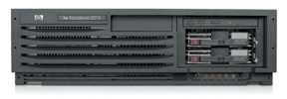

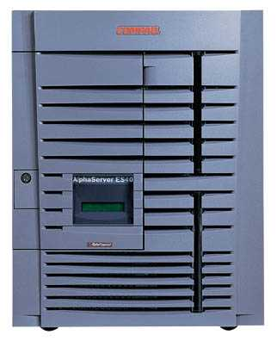
SQL Injection: Basic Picture
Victim server
post malicious form
Attacker
1
2
3
receive valuable data
unintended query
This is an input validation vulnerability
Unsanitized user input in SQL query to back- end database changes the meaning of query
Victim SQL DB
16

Slide 17
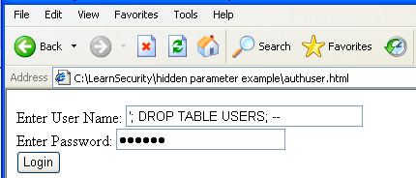
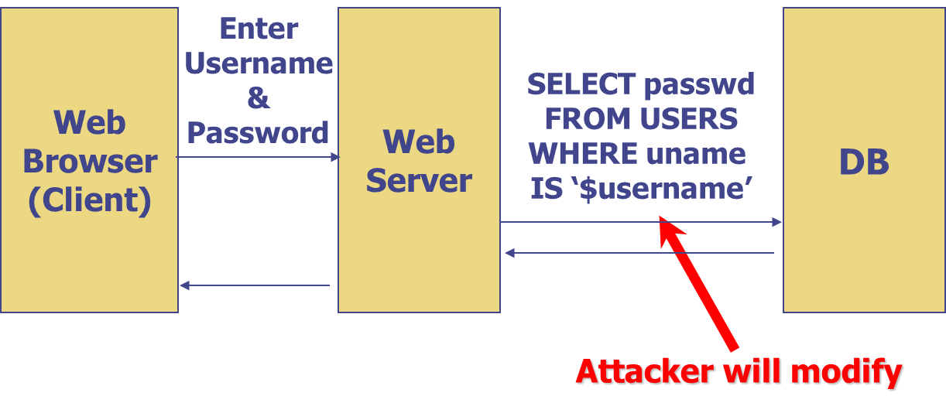

Slide 18
SQL Injection Example
Application Java code contains SQL statement:
String query = "SELECT * FROM users_table " +
" WHERE username = " + " ‘ " + username + " ‘ " +
" AND password = " + " ‘ " + password + " ’ " ;
Attacker enters:
username: anyname
password: Aa’ OR ‘‘=’
Query becomes:
SELECT * FROM users_table WHERE username = ‘anyname’ AND password = ‘Aa’ OR ‘ ‘ = ’’;
Note: AND has higher precedence than OR!

Slide 19
More Malicious Example
What if the attacker’s password is:
Aa’; DROP TABLE users_table; --
Query becomes:
SELECT * FROM users_table WHERE username = ‘anyname’ AND password = ‘Aa’; DROP TABLE users_table; -- ’;
Note: The use of -- comments out the final quote
The attack is active:
Causes the entire database to be deleted

Slide 20
Another Example
Application Java code contains SQL statement:
string sql = "select * from client where name = ‘" + name + "’“;
Attacker enters:
Blake’ OR 1=1; -- → name = ‘Blake’ OR 1=1; --
’ OR ‘1’ = ‘1 → name = ‘’ OR ‘1’=‘1’;
’; DROP TABLE client; SELECT * FROM clientinfo where ‘t’ =‘t

Slide 21
Other Injection Possibilities
Add new data to the database
Perform an INSERT in the injected SQL
Could be embarrassing
Modify data currently in the database
Perform an UPDATE in the injected SQL
Could be very costly to have an expensive item suddenly be deeply ‘discounted’
Gain access to other user’s system capabilities
by obtaining their password

Slide 22
Notes on Active Attack
Usually data destruction is not your worst fear, as there is low economic motivation:
But who knows!
Requirement
Depends on knowledge of database, e.g., table name
One security guideline:
Use non-obvious table names, and never expose them to user
Not a silver bullet!

Slide 23
How to Get DB Information
Information is sometimes exposed to the user in debug code called during a database error.
Error messages can reveal information to hacker
Hackers can probe for SQL injection vulnerability.
Tools can probe for vulnerability

Slide 24
A Few Examples
Schema field mapping
SELECT fieldlist FROM table WHERE field = 'x' AND email IS NULL; --';
Gives whether email field exists in the table!
Similarly whether userid, passwd, name fields are in table.
Finding the table name
x' AND 1=(SELECT COUNT(*) FROM tabname); --
Gives whether tabname exists in database.

Slide 25
A Few Examples
Brute-force password guessing!
WHERE email = 'bob@example.com' AND passwd = 'hello123';
Can try it many times!
How is it different from trying username/passwords in logins?!
No failure checks!
Mail me new pass password!
x'; UPDATE members SET email = 'steve@unixwiz.net' WHERE email = 'bob@example.com
See here for more examples:
http://www.unixwiz.net/techtips/sql-injection.html

